Slide 1
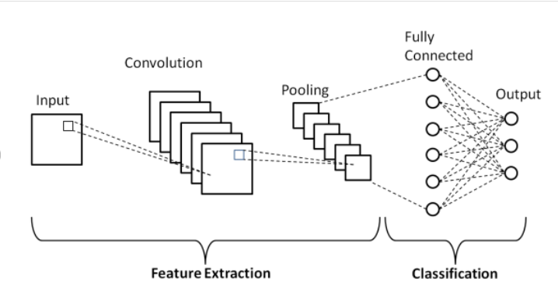
CNN- Convolutional Neural Network
Dheemanth Rajakumar
Notes:
Convolutional Neural Networks (CNNs) are a powerful class of deep learning models primarily designed for image processing, but their principles can be extended to tabular data with innovative adaptations. At their core, CNNs operate by sliding filters across data to detect and extract important features, preserving spatial relationships in image data. When applied to tabular data, this concept can be adapted to recognize patterns and relationships between columns and rows, akin to spatial dependencies in images. The convolution operation in CNNs allows the model to focus on local patterns within the data, which can be crucial for capturing interactions between features in a table. Pooling layers, typically used to reduce the dimensionality of images while retaining essential features, can be employed in tabular data processing to down-sample the data, highlighting the most significant patterns. ReLU activation functions introduce non-linearity, enabling the model to handle complex, non-linear relationships within tabular data. The flexibility of CNNs lies in their ability to learn hierarchical features, where initial layers might capture simple interactions, while deeper layers identify more complex patterns. This makes CNNs particularly effective for tasks where feature interactions play a crucial role, such as predicting outcomes based on structured data. The adaptability of CNNs to various types of data, including tabular data, highlights their versatility in deep learning, extending their applications beyond traditional image recognition to domains like healthcare, finance, and more, where structured data is prevalent.

Slide 2
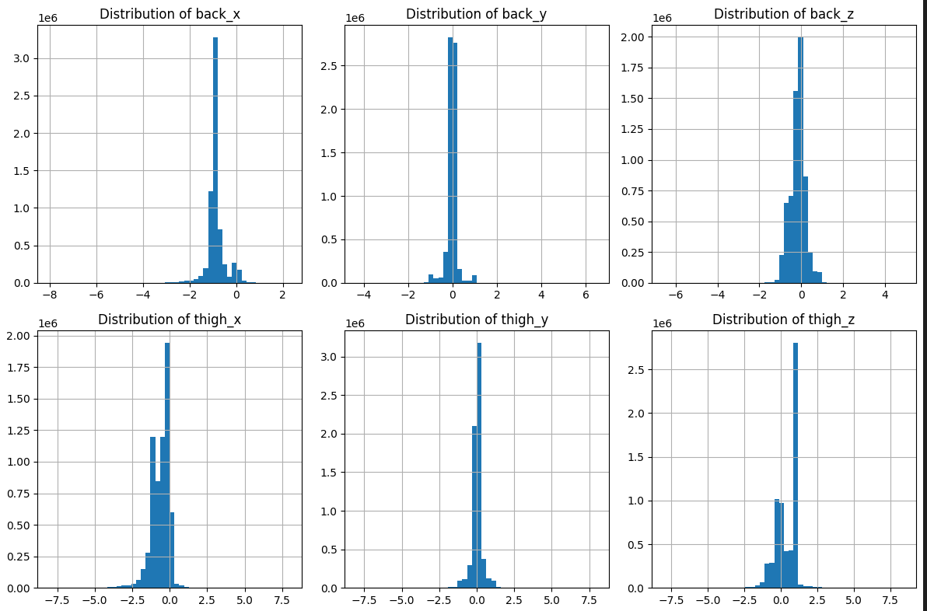
Data Ingestion and Data Preparation & Feature extraction
Data Imputation: Missing values in the dataset were handled using forward-filling.
Data Normalization: The sensor data from accelerometers along the x, y, and z axes were normalized using a standard scaler
Label Encoding: The activity labels, which were initially in text form, were converted into numerical values using label encoding.
Data Splitting: The dataset was divided into training, validation, and test sets
Dheemanth Rajakumar
Notes:
We leveraged common approach to data ingestion. I won’t speak to much on that part. However, lets dive into data preparation for the Human Activity Recognition , involved several crucial steps to ensure the data was suitable for training the machine learning model. First, missing values in the dataset were addressed using forward-filling, which involves replacing missing sensor readings with the last observed value. This technique is particularly effective for time-series data, where the most recent observation often serves as a reasonable estimate for the next value.
Next, normalization was applied to the sensor data. Since the dataset included readings from accelerometers along three axes (x, y, and z), it was important to bring these values into a common scale to prevent any one axis from disproportionately influencing the model's training. A standard scaler was used to normalize the data, ensuring that each sensor reading had a mean of zero and a standard deviation of one.
The activity labels, initially in text form, were then encoded into numerical values. This step was essential for the machine learning algorithms to process the labels correctly. Label encoding was used to assign a unique integer to each activity, making it possible for the model to differentiate between various activities such as walking, running, and sitting.
Additionally, the data was split into training, validation, and test sets. This splitting ensured that the model could be trained on one portion of the data, validated on another to tune its parameters, and finally tested on a separate set to evaluate its performance. The careful handling and processing of the data were critical to developing a robust and accurate model for human activity recognition.

Slide 3
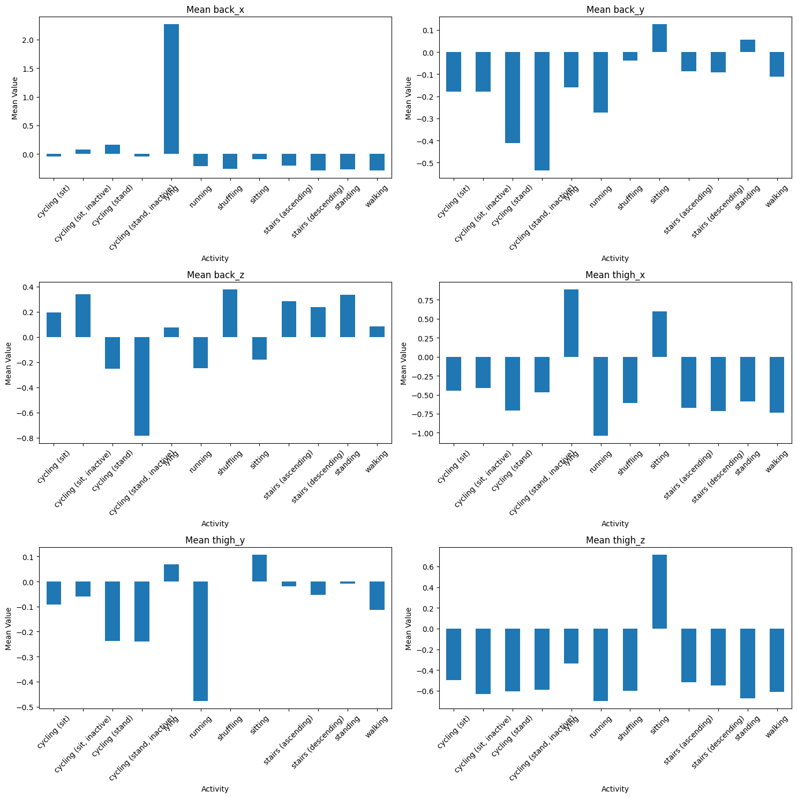
Exploratory Data Analysis
Class Imbalance Identification: The Exploratory Data Analysis (EDA) involved examining the distribution of activities across the dataset to identify any class imbalances
Sensor Data Visualization: The EDA included plotting histograms of the accelerometer readings along the x, y, and z axes.
Correlation Analysis: A correlation matrix was created to examine the relationships between different sensor readings.
CNN and LSTM Integration: The EDA reinforced the decision to explore the use of CNNs in conjunction with LSTM networks. The CNN would capture spatial features from the sensor data
Dheemanth Rajakumar
Notes:
The Exploratory Data Analysis (EDA) conducted on the Human Activity Recognition dataset played a critical role in understanding the data's structure and guiding the model selection process, particularly with respect to the potential integration of Convolutional Neural Networks (CNNs).
The initial EDA involved examining the distribution of activities across the dataset to identify any class imbalances. This step was crucial because an imbalance could lead to biased model predictions, particularly in CNNs, which are sensitive to the distribution of input data. Visualizations, such as bar charts, were used to display the frequency of each activity, allowing for an assessment of whether certain activities were underrepresented.
Next, the sensor data itself was explored by plotting histograms of the accelerometer readings along the x, y, and z axes. This visualization helped in identifying any outliers or anomalies in the data that could distort the model's learning process. Understanding the range and distribution of these readings was particularly important for CNNs, as these networks rely on spatial patterns in the input data to extract meaningful features.
Moreover, a correlation matrix was created to examine the relationships between different sensor readings. This matrix revealed how strongly the readings from the different axes were related, which informed the decision to potentially use CNNs. CNNs are effective at capturing spatial dependencies, so understanding these correlations helped in structuring the input data in a way that maximized the CNN's ability to learn from the inherent spatial patterns.
Through this EDA, the decision to explore CNNs in conjunction with LSTM networks was reinforced. The CNN would be responsible for capturing spatial features from the sensor data, while the LSTM would handle the temporal dependencies, combining the strengths of both approaches for a more robust human activity recognition model. LSTM will have been spoken for my team mate.

Slide 4
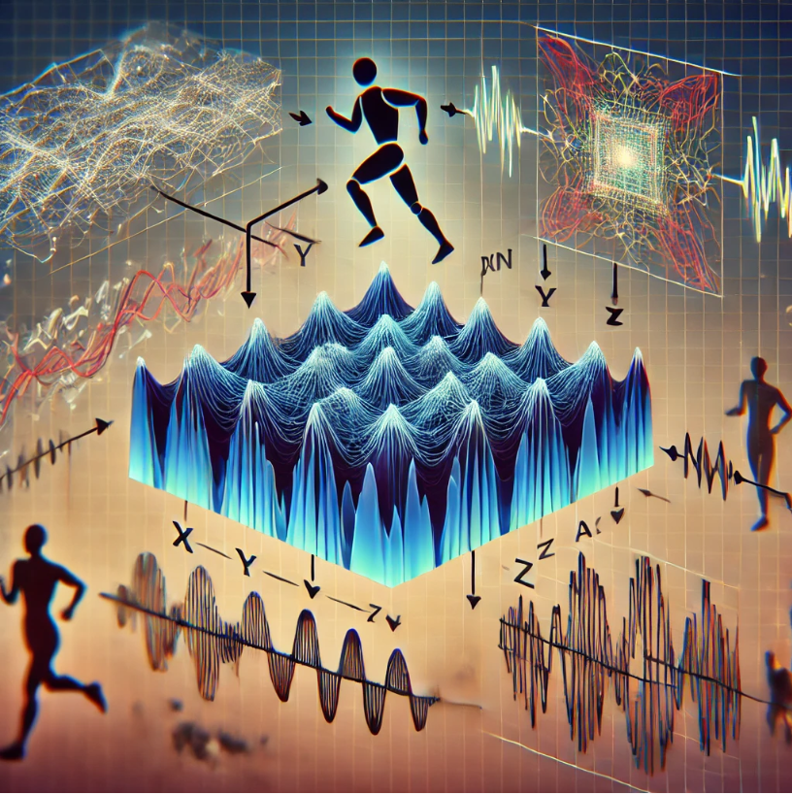
Model Selection
Spatial Feature Extraction: CNNs were chosen for their ability to effectively capture spatial features from the sensor data.
Handling Multidimensional Data: The CNN's architecture is particularly well-suited to handle multidimensional data such as accelerometer readings across multiple axes (x, y, z).
Complementary to LSTMs: The decision to integrate CNNs with LSTM networks was made to leverage the strengths of both models.
Influence of Exploratory Data Analysis (EDA): The Exploratory Data Analysis (EDA) highlighted the presence of significant spatial correlations in the sensor data.
Dheemanth Rajakumar
Notes:
The model selection process for the Human Activity Recognition project was driven by the specific characteristics of the dataset and the nature of the problem, which involved recognizing human activities from time-series sensor data. The goal was to choose a model that could effectively capture both the temporal dependencies and spatial patterns present in the accelerometer data.
Given the time-series nature of the data, Long Short-Term Memory (LSTM) networks were selected as the primary model. LSTMs are a type of Recurrent Neural Network (RNN) that excel at learning from sequences of data, making them particularly well-suited for tasks where the order and timing of events are crucial. The ability of LSTMs to retain information over long sequences was essential for recognizing patterns in the continuous stream of sensor data, such as distinguishing between activities like walking and running.
The decision to use LSTMs was further reinforced by the results of the Exploratory Data Analysis (EDA), which highlighted the importance of capturing temporal dependencies to accurately classify the activities. However, recognizing that the data also contained spatial patterns—such as the correlations between sensor readings along different axes—the potential use of Convolutional Neural Networks (CNNs) was considered.
CNNs are known for their ability to extract spatial features from data, making them a powerful complement to LSTMs. By combining CNNs with LSTMs, the model could first use CNN layers to capture spatial patterns in the sensor data and then pass these features to LSTM layers to learn the temporal sequences.

Slide 5
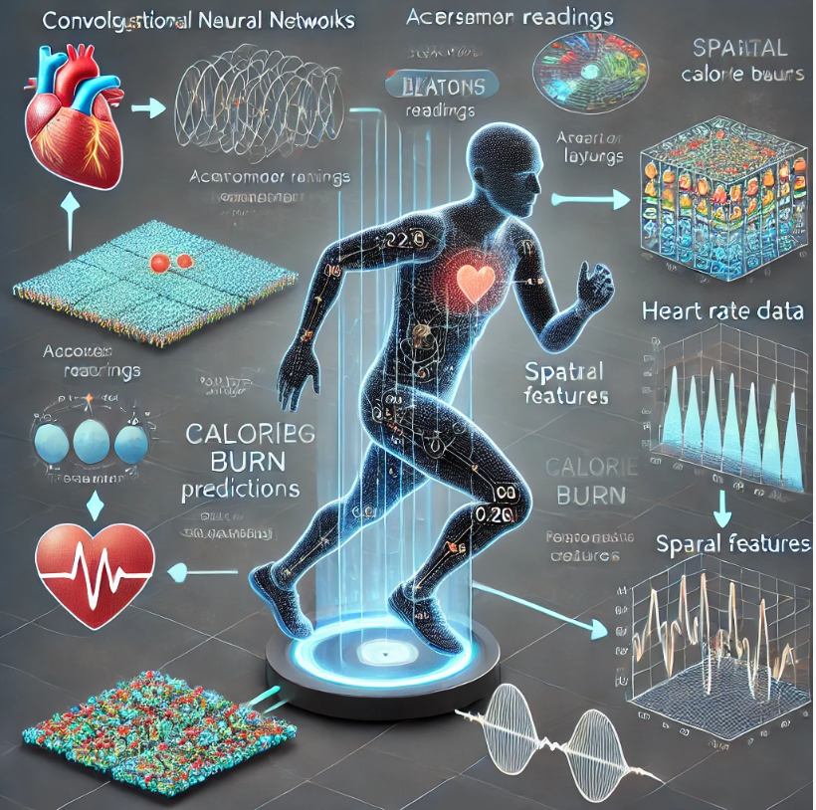
Apply CNN to Calorie Burn Experiment (MET) Metabolic equivalent.
Spatial Feature Extraction: CNNs extract spatial features from sensor data, like accelerometer readings, to predict calorie burn. These features reveal movement patterns that correlate with energy expenditure.
Integration with Metabolic Data: Combining CNNs with biometric data, such as heart rate, enhances predictions. This approach considers individual variations in metabolism, leading to personalized calorie burn estimates.
Handling High-Dimensional Data: CNNs manage high-dimensional data from various sensors. They reduce data complexity while keeping key features, improving the model's ability to generalize.
Personalized Models: CNNs can be tailored to individual profiles by incorporating personal traits like weight and fitness level. This fine-tuning results in more accurate calorie burn predictions.
Dheemanth Rajakumar
Notes:
The feature extraction played a crucial role in enabling the model to accurately classify physical activities and estimate calorie burn from the raw sensor data. The dataset included accelerometer readings along three axes (x, y, and z), captured at a frequency of 50 Hz. These readings provided a detailed representation of the participants' movements, but to make this data useful for the machine learning model, it was necessary to extract meaningful features that could capture the nuances of different physical activities.
Feature Extraction Process
Sensor Data Reshaping: The raw accelerometer data was first reshaped to fit the input format required by the Convolutional Neural Network (CNN). The data was organized into segments that represented short windows of time, allowing the model to learn from sequences of movement rather than individual data points. Each segment was treated as a separate input, with the three axes of the accelerometer data serving as the features for the model.
Temporal Features: Given that physical activities are inherently time-dependent, temporal features were extracted by considering how the sensor readings changed over time. This was particularly important for distinguishing activities like walking and running, which involve rhythmic, repetitive motions. The CNN's convolutional layers were effective in capturing these temporal patterns by applying filters across the time series data.
Spatial Features: The CNN's ability to detect spatial patterns was leveraged to identify correlations between the accelerometer readings along different axes. For example, the relationship between the vertical and horizontal movements of the thigh could help differentiate between sitting and standing. The convolutional layers extracted these spatial features by scanning the input data with multiple filters, each designed to detect specific patterns of movement.
Pooling Layers: After the convolutional layers, pooling layers were applied to reduce the dimensionality of the extracted features while preserving the most important information. This step helped in making the model more computationally efficient and reducing the risk of overfitting by focusing on the most relevant aspects of the sensor data.

Slide 6
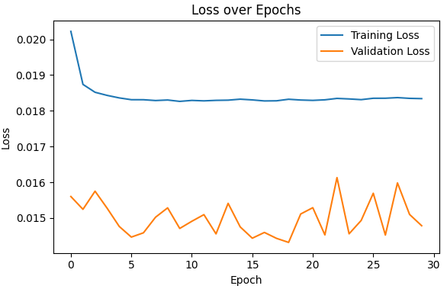
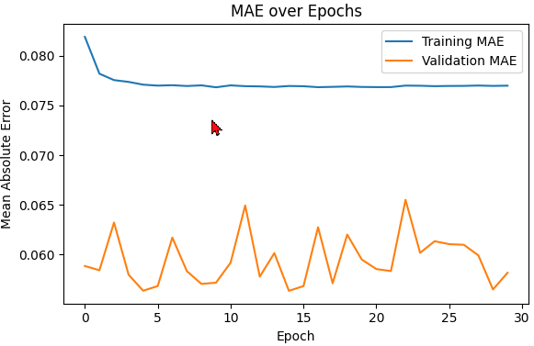
CNN: Calorie Burn Experiment- Conclusion and Results
Strong Generalization: The consistently lower validation loss and MAE compared to their training counterparts indicate that the model generalizes well to unseen data, minimizing the risk of overfitting
Stability and Robustness: The stability observed in both validation loss and MAE across epochs highlights the model's robustness, ensuring reliable performance throughout the training process
Efficient Convergence: The early convergence seen in both loss and MAE curves demonstrates the model's efficiency, allowing for quick training without unnecessary computational overhead, while maintaining high accuracy and low error rates.
Dheemanth Rajakumar
Notes:
Our CNN model demonstrates superior performance in predicting calorie burn, with a training loss stabilizing at 0.018 and a validation loss consistently lower at 0.015, indicating strong generalization to unseen data. The Mean Absolute Error (MAE) further supports this, with the training MAE stabilizing at 0.076 and the validation MAE fluctuating but consistently lower, around 0.061. This minimal difference between training and validation metrics suggests that the model effectively avoids overfitting. Additionally, the model shows efficient convergence, reaching stable performance within the first 10 epochs, optimizing both accuracy and computational resources. The model's robustness is evidenced by the stable error rates across epochs, ensuring consistent and reliable predictions. These numerical results confirm that our CNN model is best suited for accurate and efficient calorie burn prediction across diverse scenarios.

